Slide 1
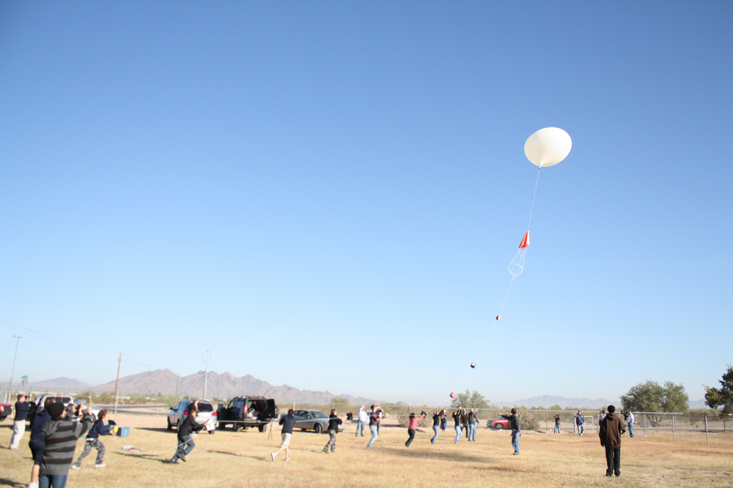
University of Arizona ASCEND!
Team Members:
Tiara Cottam, Andrew Dotson,
Michael Palmer, Kyle Stephens
Team Mentor:
Mike Borden

Slide 2
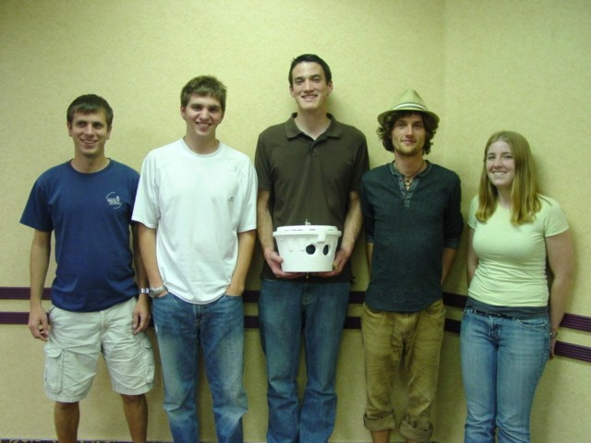
Objectives
Fall Semester:
Take high quality panoramic images of the earth
Use a timing circuit to automate and synchronize cameras
Spring Semester:
Take the solar spectrum at different altitudes
Learn about cost effective solar spectroscopy

Slide 3
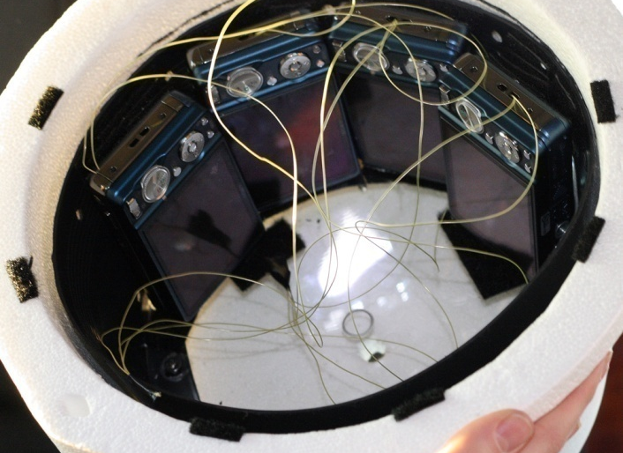
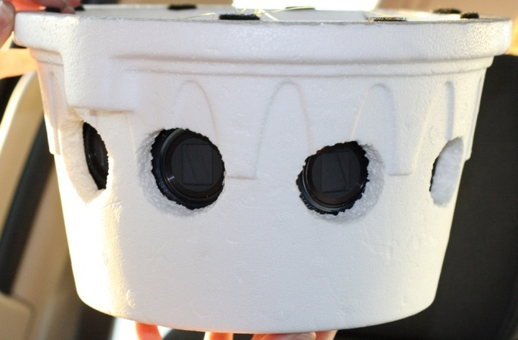
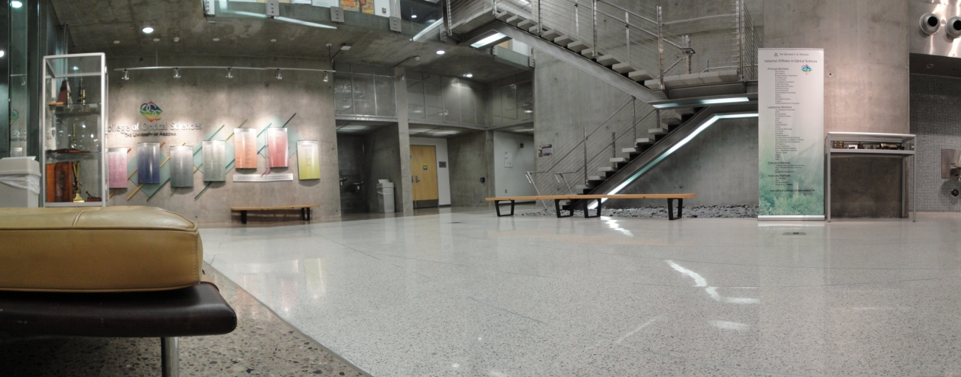
Payload: Fall Semester
Four Sony Cybershot DSC-W290 (12 MP) cameras
FOV of one camera: 35°
Total panoramic FOV: 135°
Timing circuit was used to sync cameras
Timing interval: 1 picture every 10 seconds

Slide 4
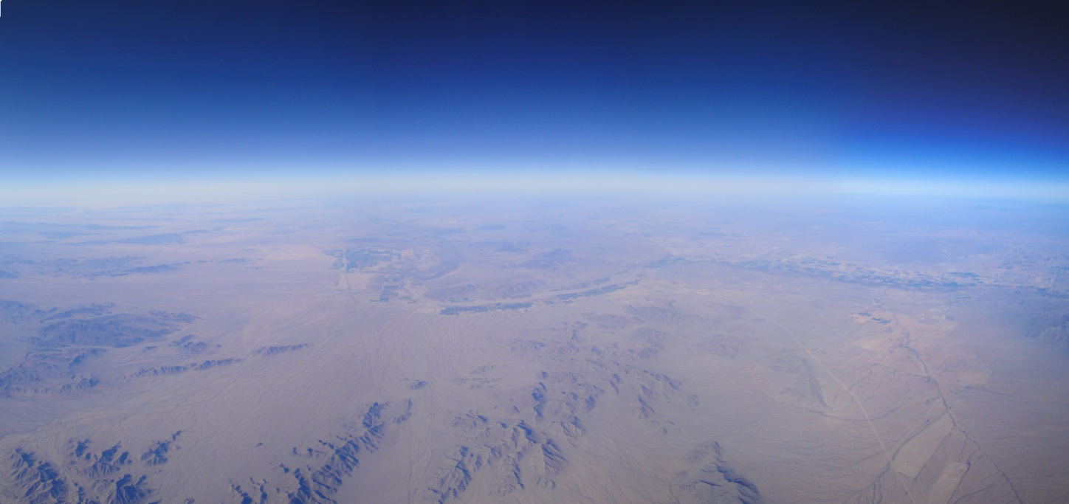
Results: Fall Semester
Cameras worked up until about 40,000 ft when timing circuit failed
200 pictures per camera were obtained with about 40% able to be merged

Slide 5
Spectrometer Temperature
Temperatures ranged from 60°F to 90°F
Spectrometer temperature affects the magnitude of each spectrum collected
Temperature data was to be used to calibrate raw data
Balloon Burst
Landing

Slide 6
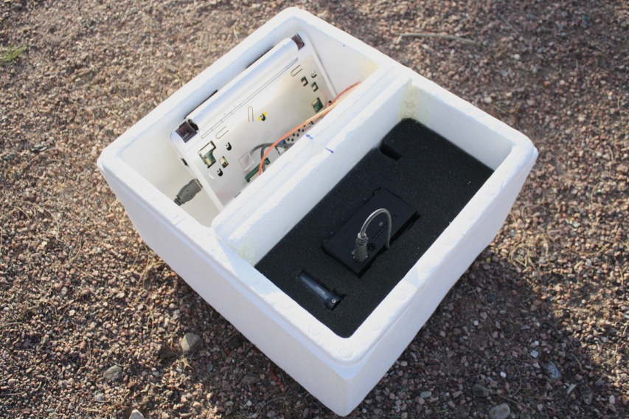
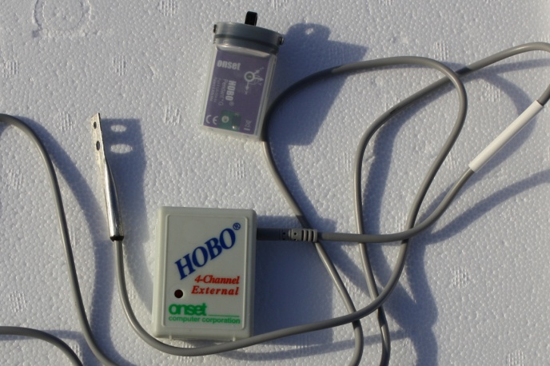
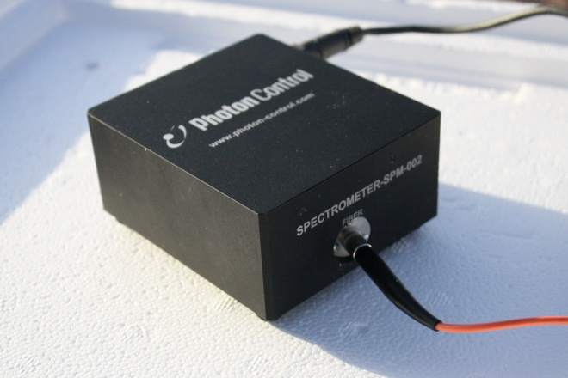
Payload: Spring Semester
Laptop
Asus EeePC
Removed monitor to conserve power and weight
HOBO Data Loggers
4 Channel HOBO connected to a thermistor by spectrometer
3-axis data logger used to track payload position
Spectrometer
350nm-1000nm
0.2 second exposure
Data taken every 5 seconds

Slide 7
Post Launch Data Reduction
Assumptions
Higher Magnitudes means Fiber Pointed at Sun
Good Spectrums taken from High Magnitudes
Altitude Data matched to Spectrum timestamp
Data
1084 total spectrums
3,440 Data Points per spectrum
Spectrums logged every 5 seconds
Converted from log file to Excel Workbook
Normalized Data
Reduced statistical errors in our measured data

Slide 8
Results: Spring Semester
H₂O present

Slide 9
Results: Spring Semester

Slide 10
Results: Spring Semester

Slide 11
Results: Spring Semester
H₂O not present
O₂ not present

Slide 12
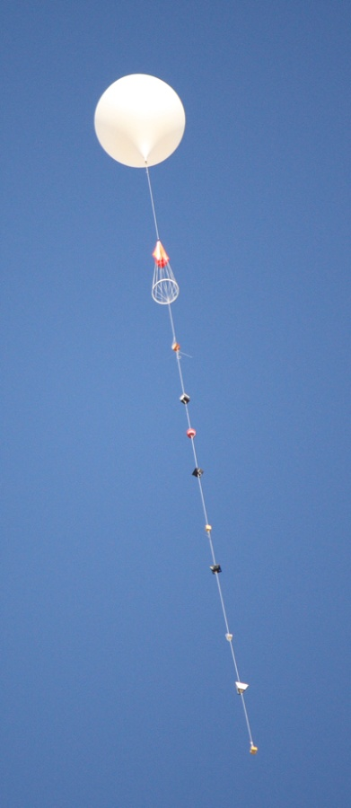
Thank You
Acknowledgements:
Arizona Near Space Research
Arizona Space Grant Consortium
Susan Brew
Mike Borden

